Slide 1


EEG Signal Acquisition and alert system for Sleeping disorder patients using RISC-V Processor on FPGA
Review-I
AY 2025-26
Capstone Project – Introduction (PROJ2999)
GITAM (Deemed-to-be) University
Department of Electrical Electronics and Communication Engineering
Project Team:
H Sahana – BU22EECE0100475
Priyanka G-BU22EECE0100446
Project Mentor:
Dr M Arun Kumar
Project In-charge:
Jaya Prakash Sahoo
www.gitam.edu

Slide 2
Objective and Goals
Objective
Acquire brainwave signals (EEG) using external electrodes and preprocess them (filtering, noise removal, amplification) for reliable input into the FPGA-based RISC-V processor.
To implement real-time EEG signal analysis (e.g., detection of abnormal patterns like sleep apnea or insomnia indicators) using a RISC-V processor on FPGA for faster computation compared to software-only methods.
To design an alert mechanism (visual via LEDs/7-segment display or auditory via buzzer) that notifies caregivers or patients in case of detected abnormalities in EEG patterns related to sleeping disorders.
Goals
Main Goals:
Capture and process EEG signals in real time using an FPGA-based RISC-V processor.
Detect abnormal brainwave patterns linked to sleep disorders (apnea, insomnia).
Provide timely visual/audio alerts to patients or caregivers to prevent risks.
Additional Goals:
Ensure low-power and cost-efficient design for continuous patient monitoring.
Enable easy data logging and visualization for doctors to support diagnosis.

Slide 3
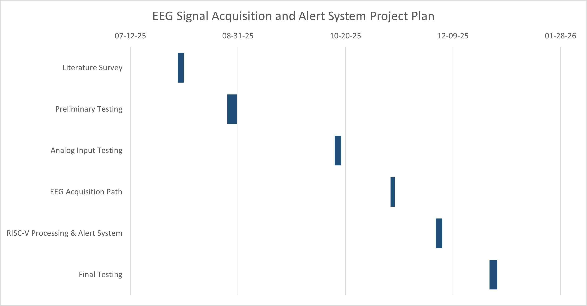
Project Plan (Clearly mention milestone for objectives under each reviews)

Slide 4
Literature Survey
Key Publications
Krithiga Sree, R., & Somasundareswari, D. (2024). Sleep Apnea Detection Based on FPGA Using EEG Signals. IRJMET, Vol. 6, Issue 7
de Chazal, P., et al. (2003). Automatic classification of sleep apnea from ECG signals. IEEE Transactions on Biomedical Engineering.
Seo, H., et al. (2020). Sleep quality assessment using wearable ECG-based monitoring.
Naveed, M. Z., Amar, M., Hussain, A., & Awan, Z. A. (2024). Design & Implementation of 5-Stage 32-bit RISC-V Pipeline Processor on FPGA. 9th MDSRIC, Pakistan
Ngu Teck Joung, D. (2023). Design and Simulate RISC-V Processor using Verilog. Master’s Dissertation, Universiti Tunku Abdul Rahman
Khairullah, S. S. (2022). Hardware realization of a 5-stage 16-bit RISC processor on FPGA.
Key Resources – Whitepaper| Application Notes | Datasheet| Others
Xilinx Vivado Design Suite Documentation (for simulation and FPGA synthesis).
Xilinx Vivado Documentation for FPGA-based implementation.
Existing Implementations – Products| Opensource| GitHub etc
Open-source RISC-V cores on GitHub (https://github.com/riscvarchive/riscv-cores-list)
Wearable EEG headbands (e.g., Muse, Emotiv).

Slide 5
Sl.no | Title | Methodology | Significance | Research Gaps
01 | "Design & Implementation of 5-Stage 32-bit RISC-V Pipeline Processor on FPGA" | A 5-stage pipelined RISC-V processor is designed with instruction fetch, decode, execute, memory access, and write back stages. A hazard detection unit is used to prevent pipeline hazards like data dependencies and stalls. A static branch predictor addresses branch instructions to enhance performance. The design is in Verilog, simulated in Vivado, and implemented on a ZedBoard Zynq FPGA | The design uses a free and open-source RISC-V ISA. Pipelining and branch prediction enhance the processor's efficiency and speed by reducing clock cycles per instruction (CPI). The project is a guide for beginners on processor architecture and Verilog coding | Future work should improve branch prediction accuracy. The authors suggest advancing the RISC-V ecosystem by exploring multi-core pipeline designs and enhancing memory access.
02 | "DESIGN AND SIMULATE RISC-V PROCESOR USING VERILOG" | A 32-bit RISC-V processor is designed and simulated using Verilog, implementing a 5-stage pipeline. Key modules like ALU, memory (imem, dmem), and a register file are included. A hazard unit is implemented to mitigate hazards. The design's functionality is verified using ModelSim | The free and open RISC-V ISA provides a great alternative for designers, reducing barriers in the semiconductor industry. The 5-stage pipeline design is used to increase the processor's efficiency by executing multiple instructions simultaneously. | Future work could focus on improving branch prediction accuracy. The design can be improved by implementing different extensions to the base integer instruction set. Exploring different cache architectures and memory hierarchies is suggested to reduce memory access time

Slide 6
03 | "SLEEP APNEA DETECTION BASED ON FPGA USING EEG SIGNALS" | EEG signals from the UCDDB database are preprocessed and band-decomposed into five frequency sub-bands. Features like energy, mobility, and kurtosis are extracted from these sub-bands. A Linear Support Vector Machine (LSVM) classifier is used to distinguish between apnea and non-apnea episodes. The model's parameters are then implemented on an Artix-7 FPGA | The system achieves an impressive performance with a highest accuracy of 94.81%. It is energy-efficient, with a minimal dynamic power usage of 19mW. The hardware can be integrated into a wearable device for automated sleep apnea detection | The authors suggest connecting a wireless headset band for EEG recordings with an FPGA to improve comfort and efficiency
04 | "EEG Signal Processing for the Identification of Sleeping Disorder Using Hybrid Deep Learning with Ensemble Machine Learning Classifier" | EEG signals from the Sleep-EDF database are collected and preprocessed to remove noise and artifacts. A hybrid deep learning framework (CNN) and an ensemble machine learning classifier are used for detection. The approach combines CNN with classifiers like Random Forest, KNN, and XGBoost | The hybrid model achieves high accuracy (96.78%) and sensitivity (89.06%), outperforming conventional methods. The use of CNNs effectively extracts high-level features from EEG signals, while the ensemble learning improves generalization and reduces overfitting. | The model should be tested on larger and more varied datasets, including real-world clinical data. Further research is needed to understand the specific EEG characteristics that contribute to the hybrid model's classification.

Slide 7
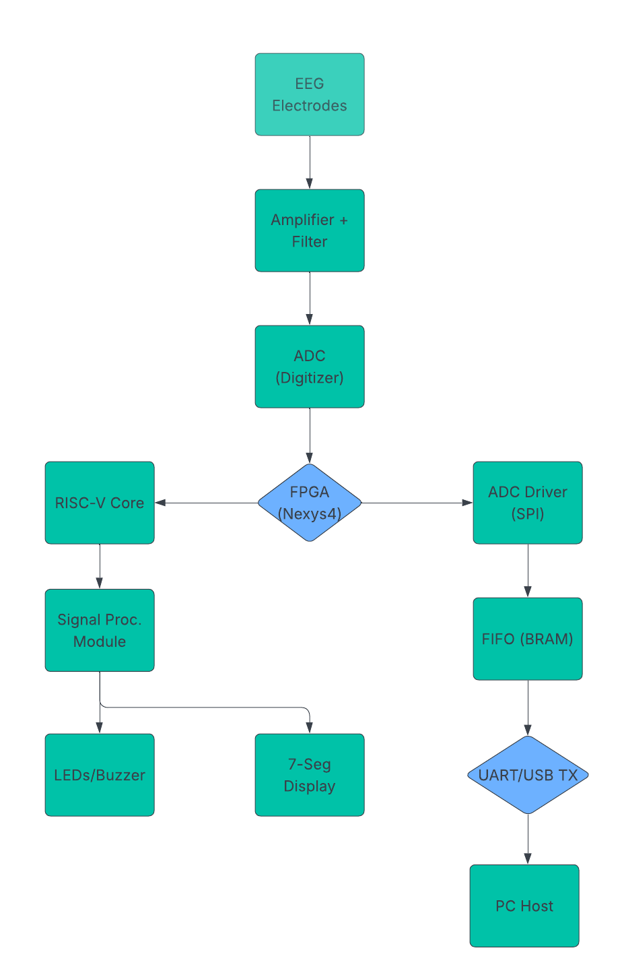
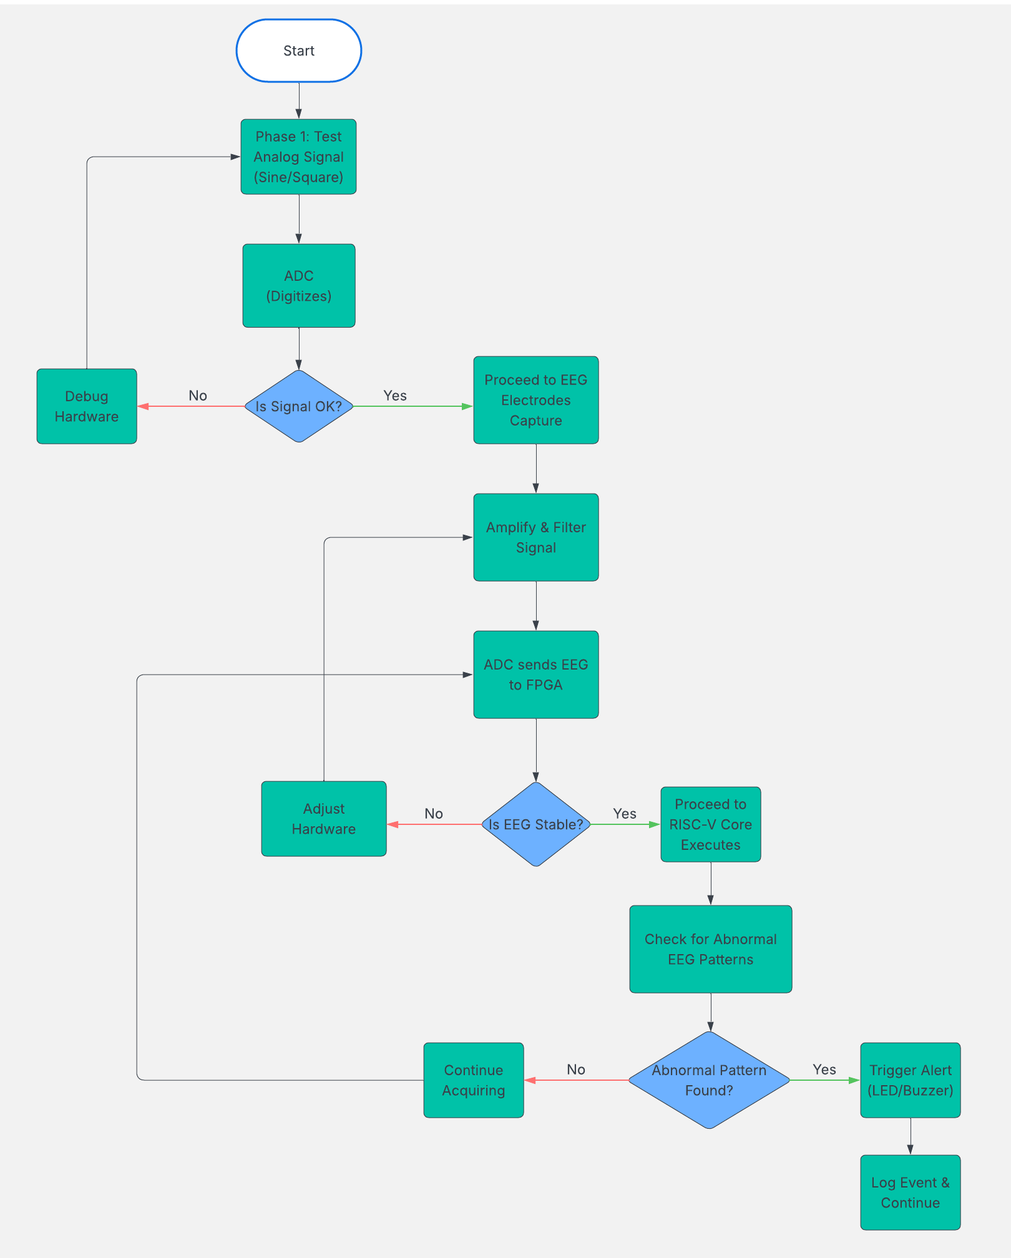
Architecture
Structural Diagram
Behaviour Diagram

Slide 8
Use Cases & Testing
Use Cases:
Real-Time Data Processing: The RISC-V processor on the FPGA handles real-time EEG signals, performing tasks like filtering and feature extraction on the embedded core.
Diagnostic Intelligence: The system uses a deep learning model to automatically classify sleep stages and detect disorders, providing a significant improvement over manual analysis.
Wearable/IoT Platform: The low-power and high-performance FPGA implementation is suitable for creating a wearable System-on-a-Chip (SoC) or a wireless headset for continuous patient monitoring.
Test Cases :
. Hardware/Processor Testing: Functional verification of the processor is done using Verilog testbenches. The hazard unit's integrity is tested with specific instruction sequences, and the overall power consumption and FPGA resource usage are benchmarked.
Signal Processing/Algorithm Testing: The diagnostic accuracy of the machine learning model is evaluated using publicly available datasets. Robustness is tested with methods like k-fold cross-validation to ensure the model performs reliably across different patients.

Slide 9
Implementation and Results – Iteration 1
Implementation – Iteration 1
● Configured FPGA infrastructure: LEDs, switches, push buttons, 7-segment display
.
● Implemented clock divider for timing control.
● Mapped digital input signals (switches/buttons) → FPGA outputs (LEDs/7-segment).
● Verified functionality through simulation and on-board testing.
Results – Iteration 1
● FPGA synthesized and programmed successfully with no errors.
● Switches and buttons correctly controlled LEDs and 7-segment display.
● Digital signal flow validated from inputs → FPGA logic → outputs.
● Outcome: FPGA infrastructure is ready for sensor interface integration in Iteration 2

Slide 10
Conclusion & Future Work
Summary and Conclusion:
The project successfully developed a robust system by integrating a high-performance RISC-V processor with advanced machine learning on an FPGA. The processor's 5-stage pipeline efficiently handled instruction execution and managed data flow. Key to its reliability is the hazard unit, which ensures correct program execution by mitigating data dependencies via forwarding and stalling. For diagnostics, the system utilizes a Hybrid Deep Learning/Ensemble Classifier to process EEG signals and classify sleep disorders with high accuracy, up to 96.78%. This validates a model for creating a low-power, high-accuracy System-on-a-Chip (SoC) solution suitable for wearable health monitoring.
Future Work
Future development should prioritize clinical readiness and further optimization. The next step is to integrate the FPGA design with a wireless headset band and communication protocol for real-time testing using genuine clinical data. On the hardware side, efficiency can be boosted by implementing a dynamic branch predictor and exploring new cache architectures and memory hierarchies to reduce memory access time. Finally, further testing on a larger, more diverse clinical dataset is required to ensure the model's reliability and generalizability across various patient populations.

Slide 11
THANK YOU
Have a Great Day !

